Slide 1
Confidence in Global Motion Direction Discrimination
Introduction
Psychophysics Experiment
Modeling
Discussion and Conclusion

Slide 2
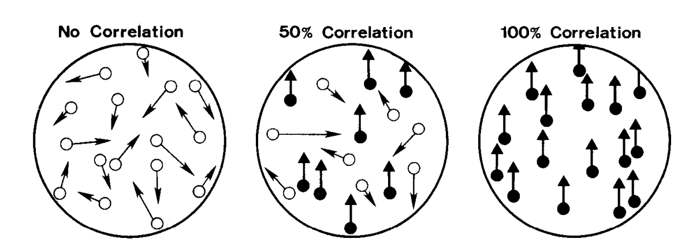
Confidence in Global Motion Direction Discrimination
Introduction
Global Motion
Global Motion Direction Processing
V1 and V2
: Direction Selectivity with Motion Energy Models (Adelson and Bergen,1984)
0
MT and MST
: Motion Integration with IOC Models (Simoncelli and Heeger,1998)
0.5
IPS (LIP)
: Evidence integration (Roitman and Shadlen, 2002) and choice (Newsome and Shadlen, 2001)
1
Coherence, Random-dot Kinematogram (RDK)

Slide 3
Confidence in Global Motion Direction Discrimination
Introduction
Global Motion Direction Processing + Confidence
: Range of Directions (Spence et al., 2016)
Local Contrast (Lee et al.,2023)
Total Positive evidence (Koizumi et al., 2015)
V1 and V2
: Direction Selectivity with Motion Energy Models (Adelson and Bergen,1984)
MT and MST
: Motion Integration with IOC Models (Simoncelli and Heeger,1998)
: Evidence integration (Roitman and Shadlen, 2002) and choice (Newsome and Shadlen, 2001)
Choice Certainty (Kiani and Shadlen, 2009)
IPS (LIP)
Medial prefrontal (pgACC)
Confidence (Gherman and Philiastides, 2018)
Comparison to internal reference (Bang and Fleming, 2018)
Formation of the Confidence in Global Motion Direction
Visual reliability mechanisms (global motion processing)
Other visual-cognitive mechanisms (comparison to internal reference, range of direction, local contrast)
Notes:
Monkey experiments done with eye movement as a medium for reporting responses. I think some people think that frontal influence is either due to working memory component or motor planning component.
Zizlsperger, L., Sauvigny, T., Händel, B., & Haarmeier, T. (2014), is between my reference, they just show there are distinct components but can be consistent with both. But they open up the discussion about something that could be different.
Fleming paper just add variable reference to at the end of trial to manipulate task difficulty in cognitive level. Thus, they find frontal regions that are tracking the integrated confidence whereas earlier areas is tracking reliability of stimuli. Interaction is this particular area,

Slide 4
Confidence in Global Motion Direction Discrimination
Introduction
Formation of the Confidence in Global Motion Direction
Visual reliability mechanisms (global motion processing)
Other visual-cognitive mechanisms (comparison to internal reference, local orientation, contrast)
The aim:
In a straightforward global motion direction discrimination task:
Identify the contributions of these mechanisms
Measure human global motion discrimination performance and confidence
Model visual reliability and confidence

Slide 5
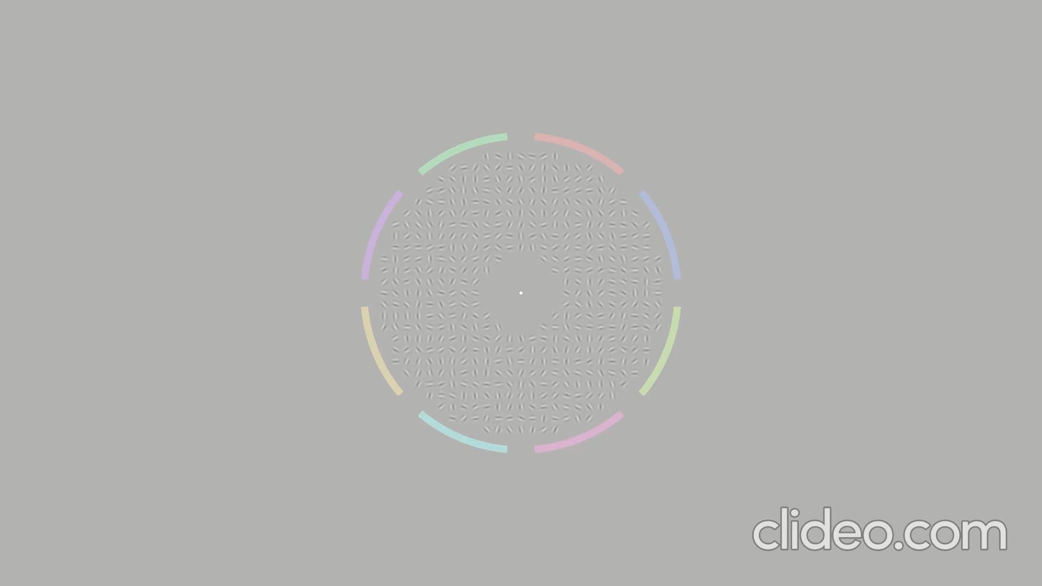
Confidence in Global Motion Direction Discrimination
Psychophysics Experiment
16’ stimuli, 4’ blank, 18’ with choice window diameter
8 possible directions of global motion
4 Coherence levels: 0.3, 0.5, 0.7 and 0.9
(fraction of Gabor patches consistent with global motion)
500 ms motion
Global Motion Speed: 0.5 degree per second
Drifting Gabors Stimuli (Amano et al., 2009)
Global Integration is more important to perceive the motion

Slide 6
Confidence in Global Motion Direction Discrimination
Psychophysics Experiment
Two Interval Confidence Forced Choice Experiment
250 -750 uniform
500 ms
until response
500 ms
until response
Interval 2
Interval 1

Slide 7
Confidence in Global Motion Direction Discrimination
Psychophysics Experiment: Perceptual Judgement
10 Participants, 6400 trials
No systematic bias for direction of motion
0.62 percent correct
0.50 of errors are small (+- 45 degrees),
0.21 of errors are the opposite direction
0.29 percent of the errors are the other four possibilities.
Notes:
We excluded three participants who are the worst because one in chance level, one did not understand the experimental instructions probably, last one does not show any effect of confidence.

Slide 8
Confidence in Global Motion Direction Discrimination
Psychophysics Experiment: Perceptual Judgement
Performance is increased with motion coherence
Errors are distributed consistently with proximity to the true direction of motion
Opposite direction is selected almost as much as the closest alternatives of the true direction of the motion

Slide 9
Confidence in Global Motion Direction Discrimination
Psychophysics Experiment: Confidence
Notes:
0.23 0.13
0.43 0.21

Slide 10
Confidence in Global Motion Direction Discrimination
Psychophysics Experiment: Confidence
Successful confidence judgements (confidence in the opposite of the true direction)
Strongly connected to perceptual performance
Strongly connected to motion coherence
Decay Bias (Raviv, Ahissar, and Loewenstein ,2012)

Slide 11
Confidence in Global Motion Direction Discrimination
Psychophysics Experiment: Summary
Aim to identify the relative contributions of visual reliability and other visual-cognitive mechanisms in forming confidence for a simple global motion discrimination task
Human performance is measured in an eight alternative global motion direction discrimination task with drifting gabors stimuli, and confidence is measured with two interval confidence forced choice.
Similar to RDK, discrimination performance increased with motion coherence, and participants were able to make successful confidence judgments strongly tied to perceptual performance.
The opposite of the true direction is selected almost as much as close alternatives, and it is reflected in confidence
Decay Bias

Slide 12
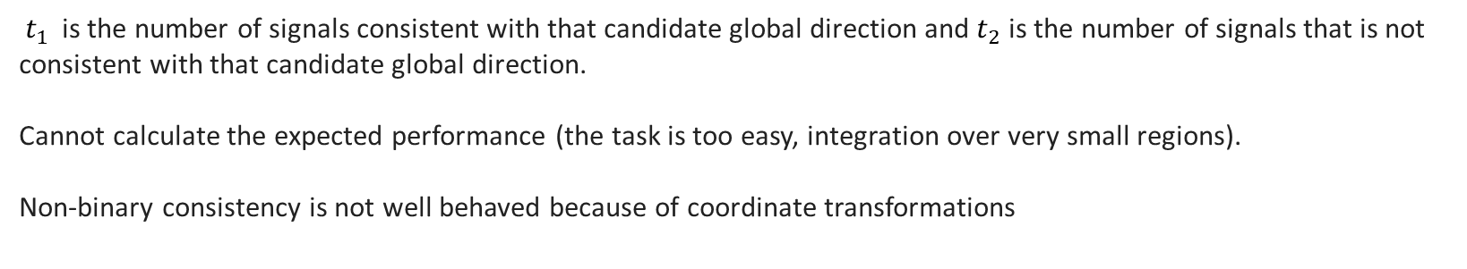
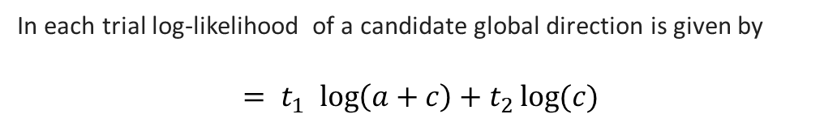
Confidence in Global Motion Direction Discrimination
Modeling
1. Bayesian Ideal Observer
In each trial log-likelihood of a candidate global direction is given by
$${= t}_{1 }\log\left(a+c\right)+t_{2}\log{(c)}$$
${ t}_{1 }$is the number of signals consistent with that candidate global direction and $t_{2}$ is the number of signals that is not consistent with that candidate global direction.
Cannot calculate the expected performance (the task is too easy, integration over very small regions).
Non-binary consistency is not well behaved because of coordinate transformations
Implementation
Perceptual performance: Consistent with perfect integration with just overall scalar noise? (Parameter 1)
$$=t_{1 }\log\left(a+c\right)+t_{2}\log{(c)}+N(0,σ)$$
Confidence performance: Based on the “max” type-1 response with bias (Parameter 2)

Slide 13
Confidence in Global Motion Direction Discrimination
Modeling
2. Template Integration Model
(i) IOC Solution
Integration of the local motion
Intersection of constraints (Simoncelli and Heeger,1998)
Drifting Gabors Stimuli – Consistent with IOC solution (Amano et al., 2009 )
Single Gabor
V1 Population Motion Energy Response
MT Population Motion Energy Response
Odd
Even
V1 Receptive Fields
MT Receptive Fields
Speed and Direction Tuning
Speed and Direction Tuning

Slide 14
Confidence in Global Motion Direction Discrimination
Modeling
2. Template Integration Model
(i) IOC Solution
Global vs. local integration
(Majaj, Carandini and Movshon, 2007; Kumbhani, El-Shamayleh, and Movshon, 2015)
We opt for global integration for convenience (limitations of our model)
Whole Stim (640 Gabors)
V1 Population Motion Energy Response
MT Population Motion Energy Response
Odd
Even
V1 Receptive Fields
MT Receptive Fields
Speed and Direction Tuning
Speed and Direction Tuning

Slide 15
Confidence in Global Motion Direction Discrimination
Modeling
2. Template Integration Model
(i) IOC Solution
We can only calculate the relevant section of MT population response (only a single global speed.)
Odd
Even
V1 Population Motion Energy Response
MT Population Motion Energy Response
V1 Receptive Fields
MT Receptive Fields
Speed and Direction Tuning
A linear-nonlinear model that operates not on the visual stimulus, but on the afferent responses of a population of V1 cells (Rust et al., 2006).
Very similar to: Kane, Bex and Dakin, 2011
If extended with multiple spatial frequency channels, theoretically similar Simoncelli & Heeger, 1998
Speed and Direction Tuning

Slide 16
Confidence in Global Motion Direction Discrimination
Modeling
2. Template Integration Model
(ii) Decorrelated Receptive Fields
Example Decorrelated Receptive Fields
Two parameters:
DT: Total Power of inhibition
DV: SD of inhibition dist.
MT Receptive Fields
Speed and Direction Tuning
MT receptive fields: comparable mostly “untuned” suppression (Inagaki et al., 2016).
Tuned suppression in V1 (Rust et al., 2006).

Slide 17
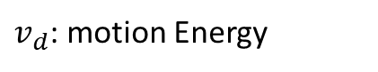
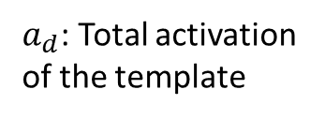
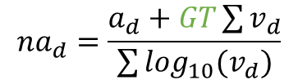
Confidence in Global Motion Direction Discrimination
Modeling
Decorrelated
2. Template Integration Model
(iii) Total Gain
V1 Population Motion Energy Response
direction d
$$na_{d}=\frac{a_{d}+GT\sum{v_{d}}}{\sum{\log_{10}(v_{d})}}$$
Gain Control
$a_{d}$: Total activation of the template
One parameter:
GT: Total Gain
$v_{d}$: motion Energy
MT activity increases with motion coherence
(Drifting Gabors, MEG: Amano et al., 2012; RDK, fMRI: Rees, Friston, and Koch 2000)
Baseline activity, static non-linearity (Rees, Friston, and Koch 2000)
Notes:
Baseline activity for zero coherence

Slide 18
Confidence in Global Motion Direction Discrimination
Modeling
Decay
2. Template Integration Model
(iv) Decay and Bias
V1 Population Motion Energy Response
template
Two Parameters:
FD: Decay of the first interval
B: Bias for choosing and interval
* Gain like
Bias

Slide 19
Confidence in Global Motion Direction Discrimination
Modeling
2. Template Integration Model
Summary
V1 motion energy is simulated and summed for local Gabors.
Decorrelated templates of V1 activation are used to compute the activation of a single MT neuron (IOC and decorrelation, DT: Total Power of inhibition, DV: SD of inhibition dist.)
Gain control is applied to make sure that the overall MT activity scales with motion coherence (gain control, GT: Total Gain)
Read off 8 possible global directions and for the fixed global speed in the experiment
Add Independent Gaussian Noise for each direction (V: SD of inhibition dist.)
Choose the maximum as the response (perceptual decision)
Simulate decay for the first interval’s “max” (decay, FD: Decay of the first trial)
Compare the “max” activation in two intervals with bias (bias, B: Bias for choosing and interval) (confidence decision)

Slide 20
Confidence in Global Motion Direction Discrimination
Modeling: Perceptual Judgement
IOC explains the performance better than the vector-average-like model as expected (Amano et al., 2009).
Template Integration model is quantitively slightly better than Noisy Ideal.
Vector Average Like
IOC Models

Slide 21
Confidence in Global Motion Direction Discrimination
Modeling: Perceptual Judgement
Template Integration model
Noisy Ideal model
Noisy ideal’s errors are systematic; template integration is a more qualitatively superior model.
Strong inhibition between neighboring directions accounts for the opposite-direction effect. (DV= 11.5-degree SD, DT= 1.01)

Slide 22
Confidence in Global Motion Direction Discrimination
Modeling: Confidence
Noisy ideal model
Noisy ideal model
Good quantitative model
No opposite-direction effect

Slide 23
Confidence in Global Motion Direction Discrimination
Modeling: Confidence
Template Integration model
Template Integration model
Qualitatively better than Noisy Ideal model
Strong inhibition between neighboring directions accounts for the confidence in the opposite direction effect.
Small overall bias (B= 1.02)

Slide 24
Confidence in Global Motion Direction Discrimination
Modeling: Confidence
Noisy Ideal model
Good quantitative model
No decay
Less dependent on “motion coherence”

Slide 25
Confidence in Global Motion Direction Discrimination
Modeling: Confidence
Template Integration model
Qualitatively much better model than Noisy Ideal
Decay (FD = 0.13)
Motion Coherence dependence (GT=1.44)
Overall, except for small bias and decay, visual reliability nicely predicts confidence with plausible mechanisms:
IOC integration
Strong and relatively tuned suppression
Gain Control
Opposite-direction
Total “visual reliability” difference

Slide 26
Confidence in Global Motion Direction Discrimination
Modeling: Summary
Measured human performance and confidence in eight alternative global motion direction discrimination task with drifting gabors stimuli
Human performance is better explained by models implementing IOC than vector-average-like methods.
A variation of the classic IOC model for motion integration (template integration model) is incorporated with strong and tuned suppression to explain the opposite direction effect in performance and confidence responses.
Adding a gain-like mechanism to increase MT's overall activity with motion coherence and decay in the first interval explains the confidence responses.
Overall, the IOC-like motion processing model with biologically plausible mechanisms is nicely explain the perceptual and confidence responses.

Slide 27
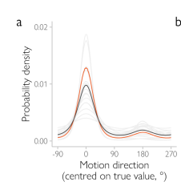
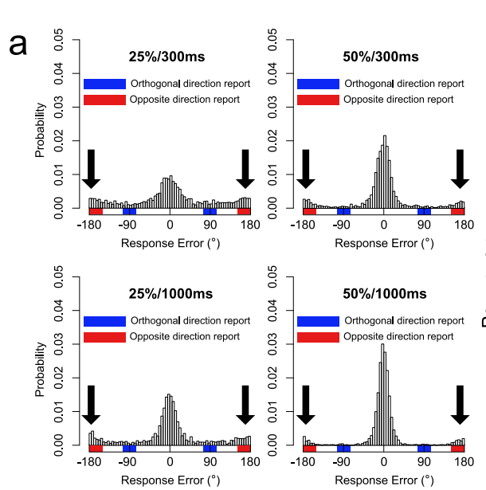
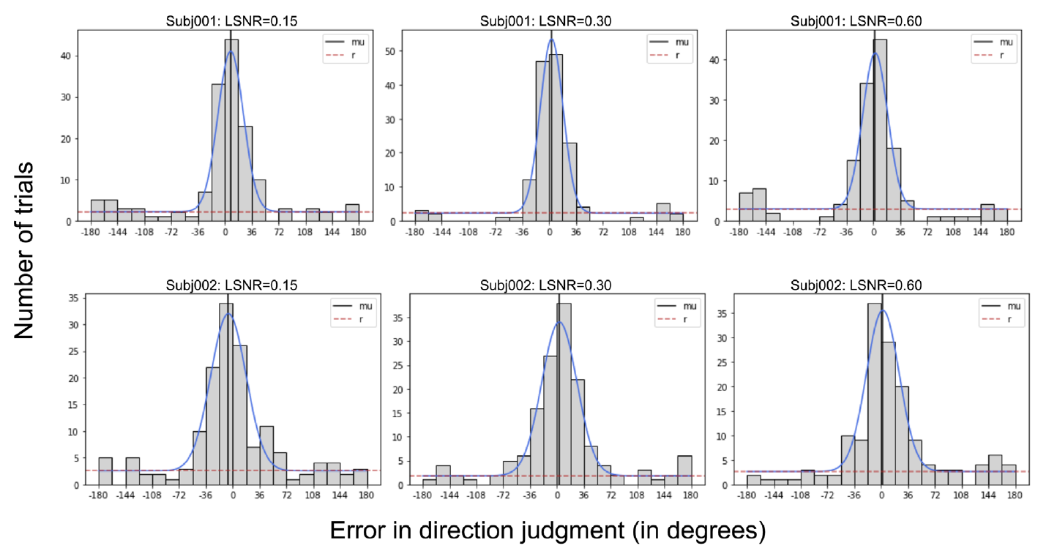
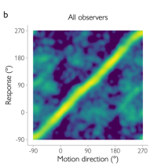
Confidence in Global Motion Direction Discrimination
Discussion
Seeing the opposite of the true direction confidently
RDK
- Consistent with previous literature
Drifting Gabors
Lee et al., 2023: Ignored in the modeling (Figure 9)
Bae and Luck, 2022 psychophysics+confidence
Chetverikov and Jehee,2023
psychophysics+fMRI

Slide 28
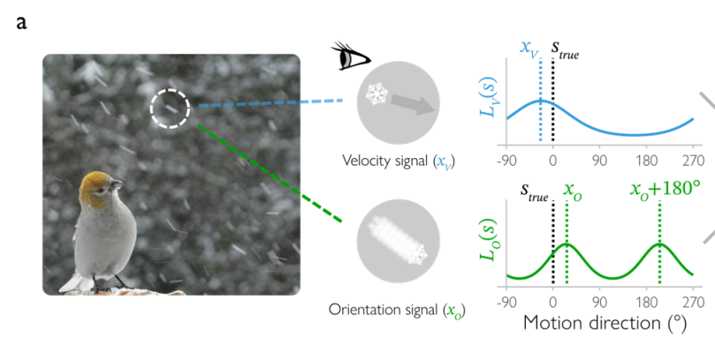
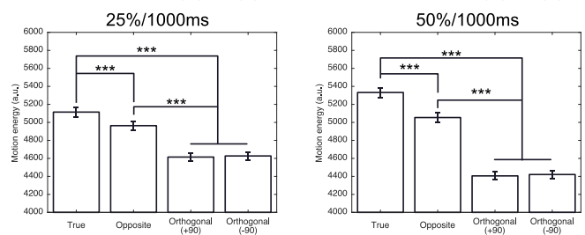
Confidence in Global Motion Direction Discrimination
Discussion
Seeing the opposite of the true direction confidently
- Mechanisms? Strong and “tuned” suppression? (Inagaki et al., 2016)
Motion streaks cue (Chetverikov and Jehee,2023)
Low-level motion energy (Bae and Luck, 2022)
Limitation of our modeling:
Ignored V1 energy in the opposite direction
Local integration
they predict no effect for slow speeds?
Future: Combination of multiple mechanisms, detailed modeling, effects size
Notes:
Bae luck: The speed of coherent motion was always 6°/s

Slide 29
Confidence in Global Motion Direction Discrimination
Discussion
The total “visual reliability”
Overall activity increases with motion coherence
Drifting Gabors, MEG: Amano et al., 2012 but failed prelimnary fMRI.
RDK, fMRI: Rees, Friston, and Koch 2000 (consistent with physiology)
But:
Decreases: Kayser et al., 2010 (predictive coding)
Saturates: Meier, Partanen, and Giaschi, 2018
Motion Coherence
Other visual mechanisms
- Minimal variation of Direction Range (Spence et al., 2016)
- No variation of Local Contrast (Lee et al.,2023)
- Variation in Total Positive Evidence (Koizumi et al., 2015)
Effects the visual reliability:
Local integration depends on the orientation similarity
Early level visual noise (V1) more effective in low contrast.
Total MT activity might be correlated with total positive evidence because of “no global motion” option.
Equal the perceptual performance, Difference in confidence
Future: Mediated by “visual reliability” (Webb et al., 2023) ? The same underlying variable.
If explains the effect:
Perceptual decisions: ‘very similar’ alternatives
Confidence for real-world: e.g. Possibility of no global direction, motion coherence effect?
If doesn’t explain the effect:
the effects size (de Gardelle and Mamassian, 2015)

Slide 30
Confidence in Global Motion Direction Discrimination
Conclusion
Similar to RDK, performance increases with coherence, and successful confidence judgments are strongly tied to the visual reliability .
The opposite of the true direction is selected almost as much as closet alternatives (45-degree difference), which is reflected in confidence responses and can be modeled with strong and tuned suppression.
Overall, except for small bias and decay, visual reliability nicely predicts confidence with biologically plausible mechanisms that implement the opposite direction activity and increasing overall activity with motion coherence.
Future Directions:
Motion Literature: Understanding the opposite-direction effect with detailed models
Confidence Literature: Other visual mechanisms can be tested with detailed models

Slide 31
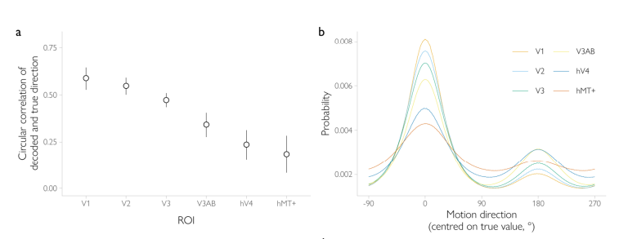
Confidence in Global Motion Direction Discrimination
Conclusion
Future Directions:
For further evidence “visual reliability with plausible mechanisms”: fMRI experiments (decoding the uncertainty)
1. Opposite-direction expected?
? RDK: Edge related orientation cues (Serences, & Boynton, 2007; Wang et al., 2014; Schellekens et al., 2017)
Drifting Gabors should not suffer from the edge related orientation cues.
Chetverikov and Jehee, 2023 – MT, V1 (visual areas)
2. Overall activity increase with motion coherence?
Increases: Amano et al., 2012, Rees, Friston, and Koch 2000
Decreases: Kayser et al., 2010
Saturates: Meier, Partanen, and Giaschi, 2018
With uncertainty decoding? (No variation in Chetverikov and Jehee, 2023 )

